Slide 1
Innovative Response for Facilitating Young Refugees Social Support (I.Ref.SoS) (Project No: 2017-2-EL02-KA205-003219)
10 December 2019, Athens

Slide 2
Project Partners
OAED (Koordinatör) Greek Manpower Employment Association which is affiliated to Ministry of Labour and Social Insurance
KANEP-GSEE (Partner) Centre for educational policy development of the Greek General Confederation of Labour
DEKRA Akademi (Partner)
MONE (Partner) Ministry of National Education, Turkey

Slide 3
To provide holistic approach for young asylum seekers in order to prepare them for labor markets
Continue education
Learn language
Recognition of prior learning
Participation in social cohesion activities
Vocational training
To benefit from professional consultancy services

Slide 4
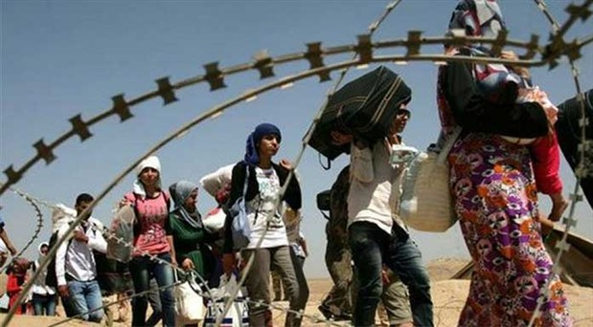
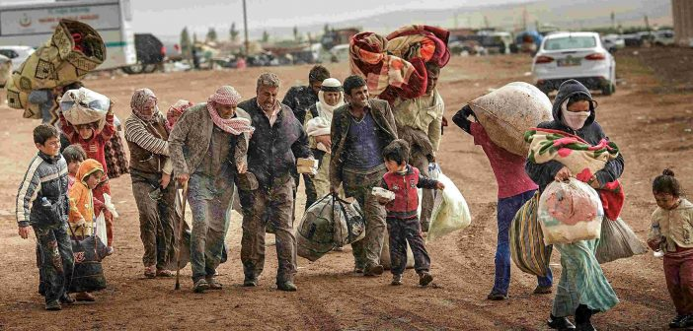
Migration from Syria
Syria Population: 22.399.254 (2012)
Migrated : 6,6 million and over
Lebanon: 4,3 milion /1.1 million
Türkiye'ye: 80 million/3,6 million

Slide 5
Law On Foreigners and International Protection (2013, Temporary Protection of Syrians)
Article 91: Temporary protection may be provided for foreigners who have been forced to leave their country, cannot return to the country that they have left, and have arrived at or crossed the borders of Turkey in a mass influx situation seeking immediate and temporary protection.

Slide 6
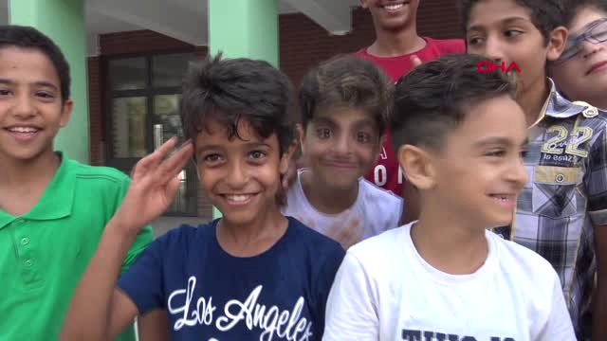
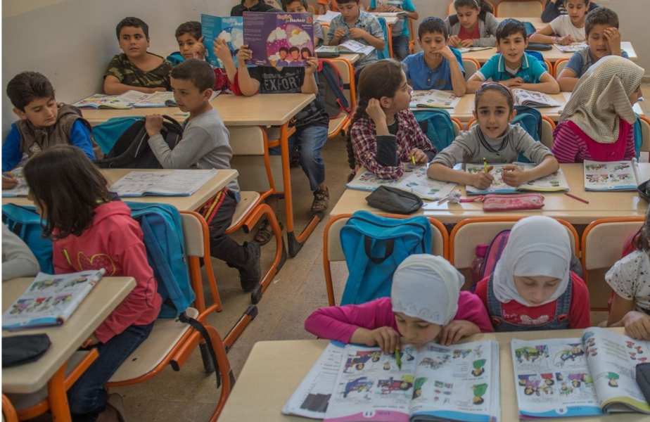
Turkey Report on Education for Young Refugees
- 1,658,482 people who make up 45.5% of the registered population are children in the 0-18 age range. The population of the era is 1 million.

Slide 7
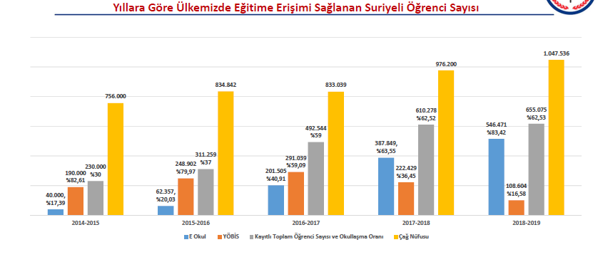
Number of Syrian Students by Years
Yellow: Era population Gray: Total Number of Students
Blue: Turkish Schools Brown: Arabic curriculum schools

Slide 8
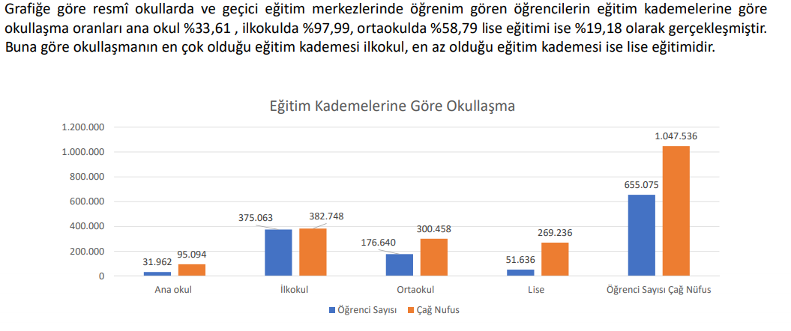
Schooling based on education levels
According to the graph, the enrollment rates of the students attending official schools and temporary education centers according to educational levels were 33.76% in kindergarten, 96.57% in primary school and 58.25% in middle school and 26.69% in secondary school. According to this, primary education is the most common level of schooling and secondary education is the least.
Middle school
primary
secondary
Age population
preschool

Slide 9
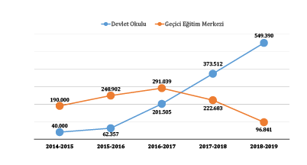
Schools of Temporary Education Centers
Public schools in Turkey are free of charge. They instruct in Turkish and teach a standardized Ministry of National Education curriculum, and are authorized to dispense certificates and diplomas to foreign national children with full validity.
TEC Schools utilize Arabic as the medium of instruction and follow a curriculum designed by the Ministry of Education of the Syrian Interim Government and modified by the Turkish Ministry of Education.
Brown line: Arabic Schools of Temporary Education Centers
Blue line: Turkish Public Schools

Slide 10
Challenges in the Schooling Group
Schools for Syrian children are not only places where they continue their academic development, but also where their needs such as socialization, integration and safety are met.
Language Barrier (introvert or aggressive attitude)
Class / Age mismatch
Academic performance (verbal-numerical)
School absenteeism and abandonment
Student-School-Parent-Administrator-Teacher-Peer Relations
Teacher-Syrian Student-Turkish Student relationship

Slide 11
Reasons of Unschooling
children having to work in families with poor economic conditions
mother tongue difference
cultural reasons (early marriage of girls)
Concern for the safety of the distance between school and home (high crime rate in the neighborhoods)
Frequent change of residence in their province
disadvantages of migration (trauma and psychological problems)
access to education for children with physical and mental disabilities

Slide 12
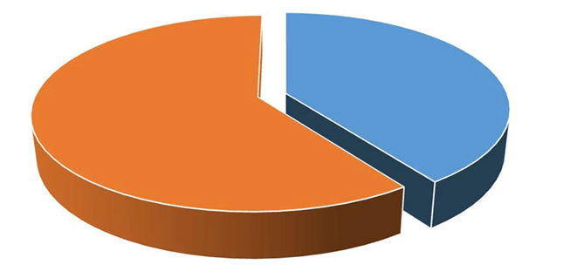
Non-formal Education
In addition to formal education activities MONE organizes courses for Syrians within the scope of non-formal education activities in hundreds of fields, including Turkish teaching. 345,927 Syrian trainees participated in these courses.

Slide 13
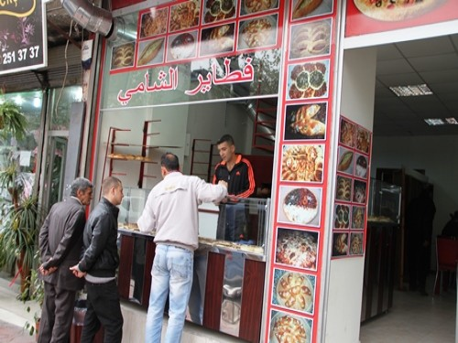
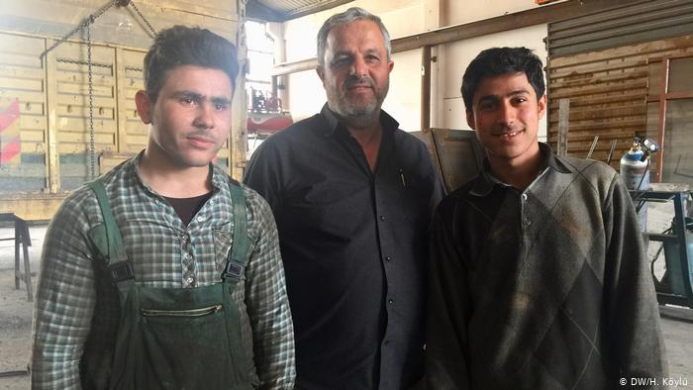
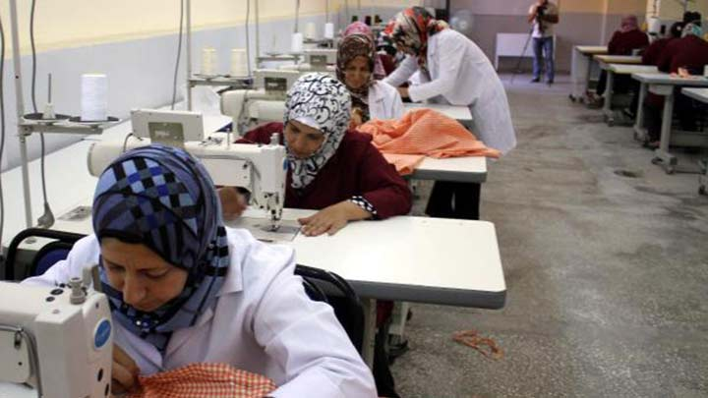
Mapping the existing practices and the efforts of Syrian youth to be employed in Turkish labour market
Notes:
Türkiye’deki Suriyeli çocukların eğitim süreci, zor koşullarda hayatlarını devam ettiren birkaç neslin geleceğini doğrudan şekillendirecek bir süreçtir.

Slide 14
The Syrian labor force is oriented towards socioeconomically low jobs.
common language problem
most of them have low level of education and cannot prove their level of education (diploma-certificate problem)
This is explained by the fact that it is easier to accept working in difficult conditions and low wages because of their economic need.

Slide 15
Priorities caused a «late» skills analysis process
Asylum seekers with academic background can not be held in Turkey due to the priority processes and delays within them during their escape from Syria (first health- second accomodation- third security- fourth education)
There were those with intellectual background, those with academic background, those with a profession didn’t stay in Turkey as the skills analysis, occupational analysis from the first day couldn’t be realized due to the scene at the Turkish border which was an unwitnessed humanity disaster since Second World War.

Slide 16
Work Permit Law; legal umbrella for Syrians
It is the employer’s responsibility to apply – after signing a contract – for a work permit on behalf of the Syrian employee via an online portal of the Ministry of Labor and Social Security. The number of Syrians under Temporary Protection cannot exceed 10 percent of the workforce at any workplace.
They are allowed to work only in the provinces they are registered in.
https://www.ailevecalisma.gov.tr/uigm/ad%C4%B1m-ad%C4%B1m-%C3%A7al%C4%B1%C5%9Fma-%C4%B0zni-ba%C5%9Fvurusu/#25-50-2019%2009:50:14-1

Slide 17
Objective :To integrate all the necessary adaptation tools to prepare young asylum seekers in the labor market
Municipalities
Migration Research Centers of Universities
Ministry of Education
Ministry of Interior
Ministry of Family, Labor and Social Services
National Defense Department
Turkish Employment Agency
Non-Governmental Organizations
International Organizations (IOM, ILO, ETF, WB etc.)

Slide 18
GUIDE for the Objective
First Stage: Describe the skills, qualifications and experiences of the individual (security, health, education, legal, etc.) who can provide assistance to citizens of different countries.
Second stage: to establish a basis for guidance; identify skills development needs; job search and job matching.
Third stage: Storing information in an accessible / common database.

Slide 19
Thank you !
Ministry of National Education
Özlem Kalkan okalkan@meb.gov.tr
GSM: +90 532 2086555
Office: +90 312 413 3920

